Slide 1
Graph Theory, Topological Analysis - Terms
Topological Analysis: General, systematic, suited for CAD
Graph: Nodes and directed branches, describes the topology of the circuit, ref. direction. Helps visualize CAD
Tree: Connected subgraph containing all nodes but no loops
Branches in tree: Twigs
Branches not in the tree: Links
Links: Cotree
Graph Theory, Topological Analysis
ECE 580
12
Notes:
1
1

Slide 2
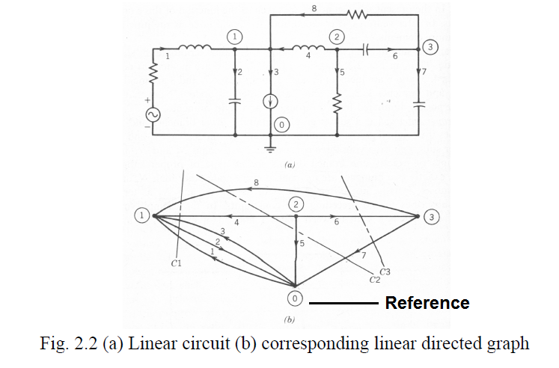
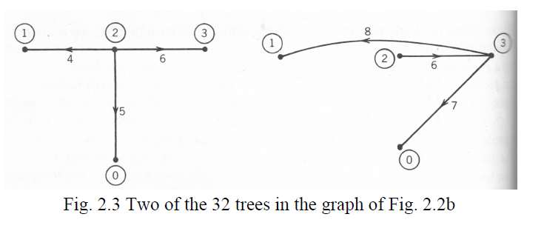
Graph Theory, Topological Analysis
Analysis steps:
KCL
KVL
Branch Relations
Linear equations: N³ operations
Sparse ~ N
Graph Theory, Topological Analysis
ECE 580
12-b
Notes:
2
2

Slide 3
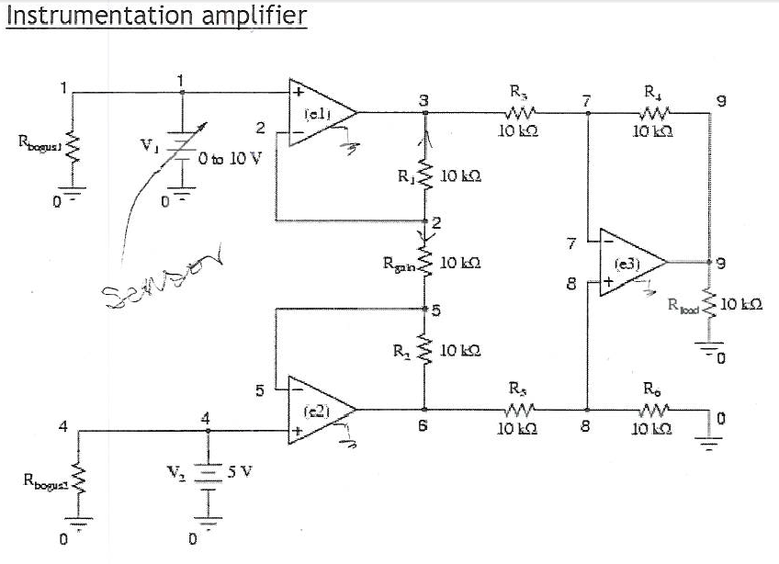
Graph Theory, Topological Analysis
Note the very high-resistance R_{bougs1} and R_{bogus2} resistors in the netlist (not shown in the schematic for brevity) across each input voltage source, to keepSPICE from think V₁ and V₂ were open-circuited, just like the other op-amp circuit examples.;
Graph Theory, Topological Analysis
ECE 580
12-c
Notes:
3
3

Slide 4
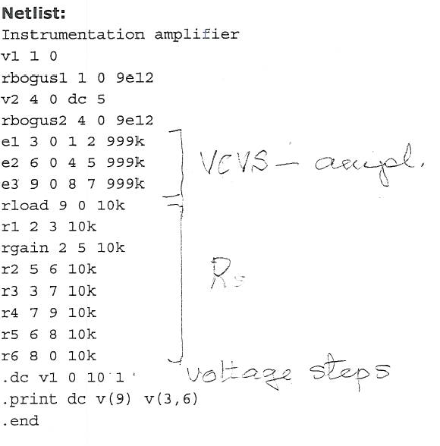
Graph Theory, Topological Analysis
Note the very high-resistance R_{bougs1} and R_{bogus2} resistors in the netlist (not shown in the schematic for brevity) across each input voltage source, to keepSPICE from think V₁ and V₂ were open-circuited, just like the other op-amp circuit examples.;
ECAP
CANCER
SPICE
Graph Theory, Topological Analysis
ECE 580
12-d
Notes:
4
4

Slide 5
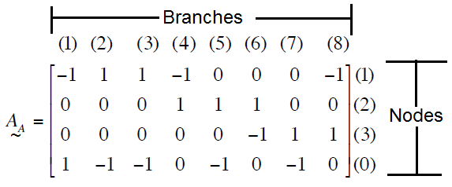
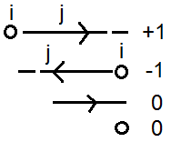
Graph Theory, Topological Analysis
Incidence Matrix A: Describes connectivity between nodes and branches
Rules for a_{ij}
+1, if branch j is directed away from node i
- 1, if branch j is directed toward node i
0, if branch j is not incident with node i
As an example, the node-to-branch incidence matrix for the graph of Fig. 2.2b
Augmented incidence matrix: Contains reference node (0)
Graph Theory, Topological Analysis
ECE 580
13-a
Notes:
5
5

Slide 6
Graph Theory, Topological Analysis
Row: Nodes; Column: Branches
One row may be omitted, since sum of entries in each column is zero. (Reference node omitted)
Resulting matrix: A. # of non-reference nodes N < # of branches B → Rank of A < N
Partitioned incidence matrix: Choose a tree, put its twigs in the first N columns of A. Then:
A = [ A _{t} | A _{c} ] ; Nonsingular A _{t} → det { A _{t} } != 0
It can be shown that det { A _{t} } = + 1; and that det { A A^{t} } = # of trees.
This proves rank A = N! Largest nonsingular submatrix is N x N.
Graph Theory, Topological Analysis
ECE 580
13-b
Notes:
6
6

Slide 7
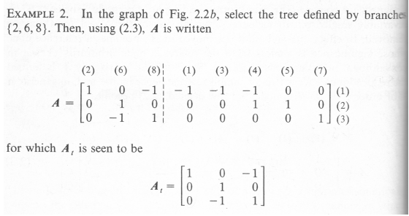
Graph Theory, Topological Analysis
Graph Theory, Topological Analysis
ECE 580
13-c
Notes:
7
7

Slide 8
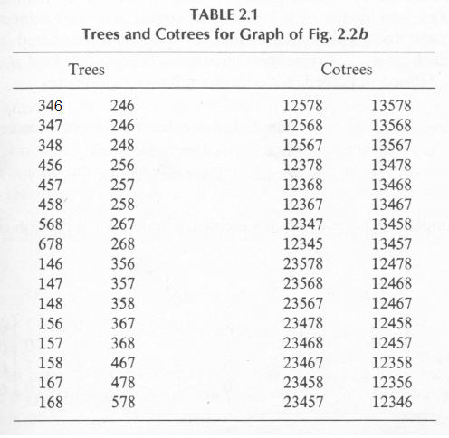
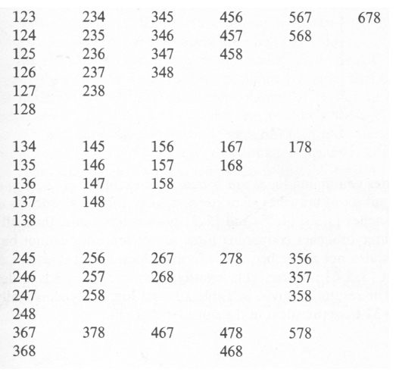
Graph Theory, Topological Analysis
Graph Definitions
These trees can be found by systematically listing possible combinations of the three branches. These are listed below.
Each entry in the list must now scrutinized to see if it contains all nodes and no loops
Graph Theory, Topological Analysis
ECE 580
14
Notes:
8
8

Slide 9
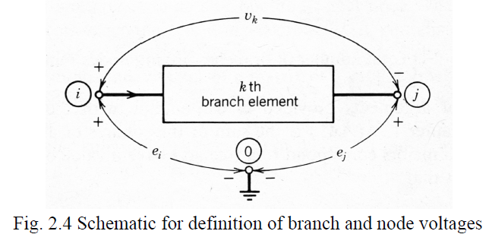
Graph Theory, Topological Analysis
Branch-to-Node Voltage Transformation: (KVL)
Branch Voltage Vector: V^{t} =[v₁,v₂,…,v_{B}]
Node Voltage Vector: E^{t} = [e₁,e₂,…,e_{N}]
By KVL, if branch k goes from node i to node j, so a_{ik} = 1 and a_{jk} = -1, then
V_{k} = e_{i} – e_{j} = a_{ik}e_{i} + a_{jk}e_{j} = [k^{th} column of A]^{t} E = a_{ik}e_{i}+…+a_{Nk}e_{N}
In general V = A^{t}E V_{k} = e_{i} - e_{j}
Branch voltages expressed in terms of node voltages → there are fewer
Purpose: formulate smallest set of linear equations before solving them
Graph Theory, Topological Analysis
ECE 580
15-a
Notes:
9
9

Slide 10
Graph Theory, Topological Analysis
KCL in Topological Formulation
KCL says the sum of currents leaving any node is zero.
Since a_{ij}= 1(-1) means branch j leaves (enters) node i, KCL for node i means:
Where I = [i₁,i₂,…,i_{B}] and 0 = [0,0,….0]
Choose a tree, and partition A and I so that A = {A_{t}|A_{c}} & I^{t} = {I_{t}|I_{c}}
Then A_{t}I_{t} + A_{c}I_{c} = 0 and I_{t}= -(A_{t})⁻¹A_{c}I_{c.}
This gives the twig currents from A and the link currents. Note A_{t} cannot be singular
Graph Theory, Topological Analysis
ECE 580
15-b
Notes:
10
10

Slide 11
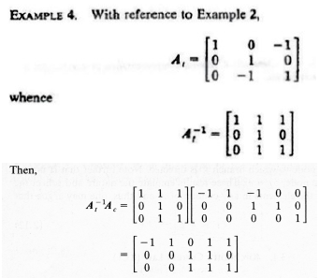
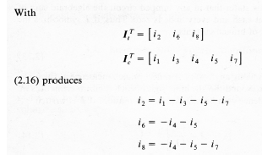
Graph Theory, Topological Analysis
Example
Twig currents can be found from link current. Fewer twigs than links.
Graph Theory, Topological Analysis
ECE 580
16
Notes:
11
11

Slide 12
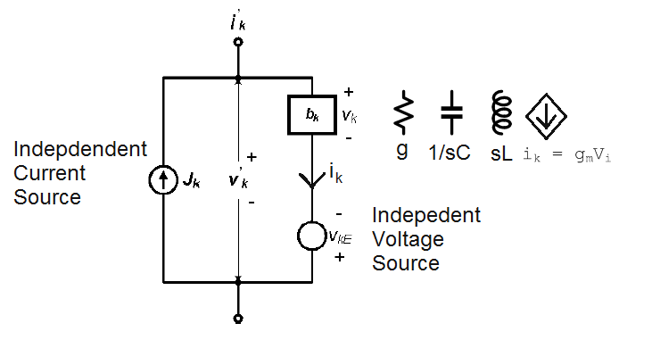
Generalized Branch Relations
Generalized Branch Relations; S-domain!
General branch for lumped linear network contains a (single) element b_{k} which may be an R,L,C and dependent sources as well as a voltage and current source which may include the representation of initial energy stored in b_{k}
Since i_{k}’=i_{k}-J_{k} and v_{k}’= v_{k} – V_{kE}
For the branch vectors I’ = I – J & V’= V – V_{E} hold
Generalized Branch Relations
ECE 580
17-a
Notes:
12
12

Slide 13
Generalized Branch Relations
Nodal Analysis
Combining the branch relations with the KVL (V’= A^{T}E) and KCL (AI’=0) gives the matrix relations
V = V_{E} + A^{T}E
AI = AJ
Result 2 equations , 3 unknown vectors
3. I = YV
Let the V-I relations of the b_{k} elements by described by the matrix relation I = YV, where the diagonal element y_{ii} of Y represents the internal admittance of the b_{i} in branch I, and the off-diagonal one y_{kl} = i_{k}/v_{l} represents a dependent I source of branch k controlled by V_{l}. By combining (1),(2) and (3), and eliminating V and I in the Laplace domain, the nodal equations Y_{N}(s)E(s) = J_{N}(s) result, where Y_{N}(s) = AY(s)A^{t} is the N x N nodal admittance matrix, and J_{N}(s) = A[J(s)-Y(s)V_{E}(s)] the equivalent nodal current excitation vector. (Due to independent sources J_{k} and V_{ke})
Generalized Branch Relations
ECE 580
17-b
Notes:
13
13

Slide 14
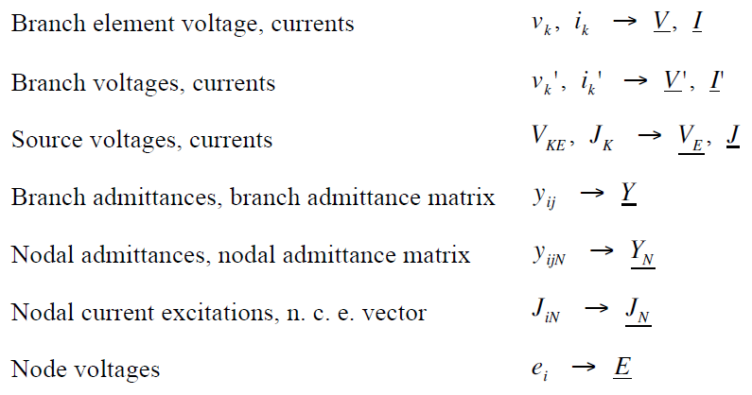
Generalized Branch Relations
Node analysis Parameters:
Generalized Branch Relations
ECE 580
18
Notes:
14
14

Slide 15
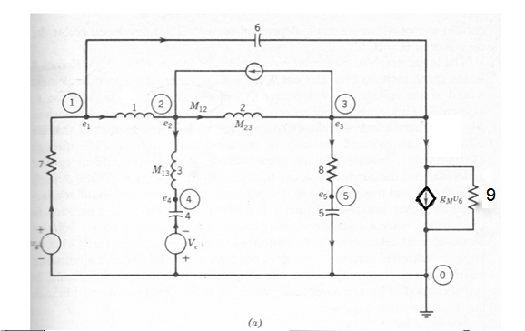
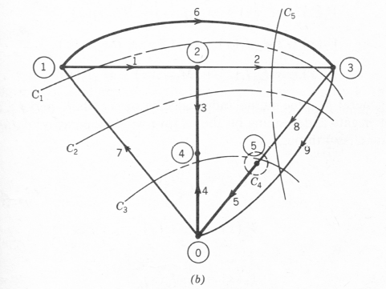
Generalized Branch Relations
Example
I₉ = G₉V₉ + g_{m}V₆
Generalized Branch Relations
ECE 580
19
Notes:
15
15

Slide 16
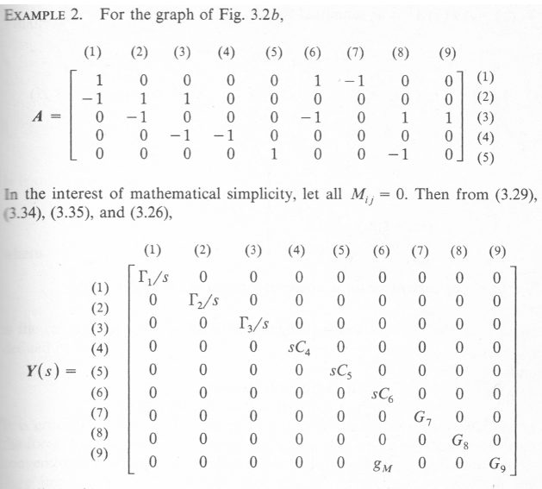
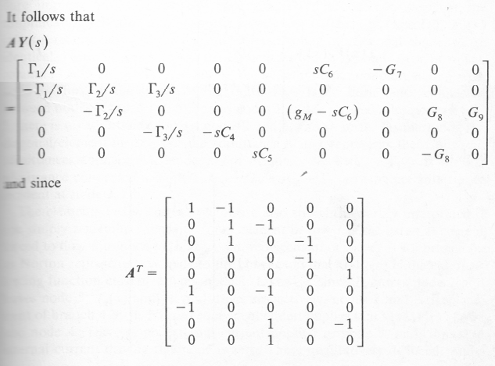
Generalized Branch Relations
Generalized Branch Relations
ECE 580
20
Notes:
16
16

Slide 17
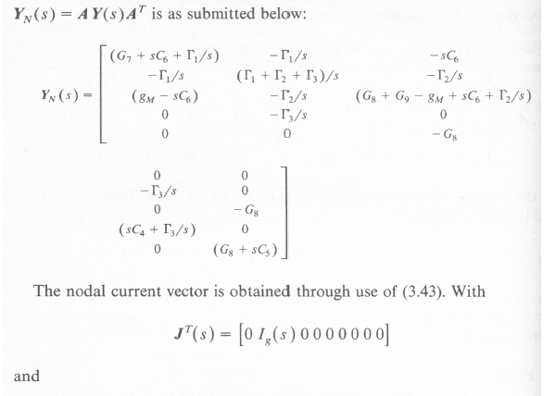
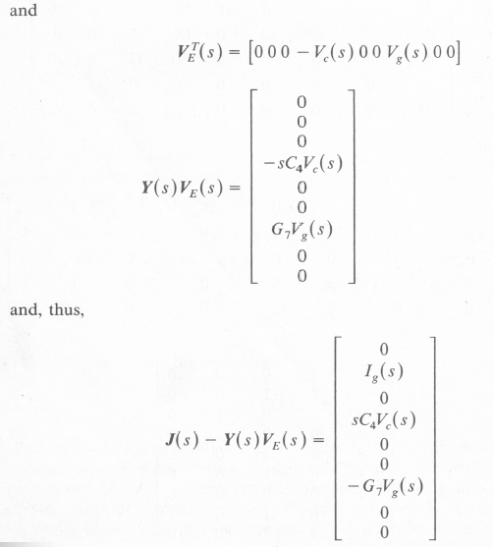
Generalized Branch Relations
Generalized Branch Relations
ECE 580
21-a
Notes:
17
17

Slide 18
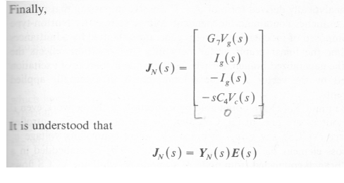
Generalized Branch Relations
Generalized Branch Relations
ECE 580
21-b
Notes:
18
18

Slide 19
Node Analysis Summary
A | Incidence Matrix, all analysis in s domain
Kirchhoff’s Laws:
V = A^{t}E | V: branch Voltage Vector E: node Voltage Vector
AI = 0 | I: branch Voltage Vector 0: zero Vector
Branch Relations:
I’ = I - J | I’: branch current vector I: element current vector J: source current vector
V’= V –V_{E} | V’: branch voltage vector V: element voltage vector V_{E}: source voltage vector
I = YV | Y: branch admittance matrix
Combining Relations:
Y_{N} = AYA^{t} | Y_{N}: node admittance matrix
V’= V –V_{E} | J_{N}: node current excitation matrix
Y_{N}E = J_{N} | Generalized node equations
ECE 580
30
Notes:
19
19

